Slide 1
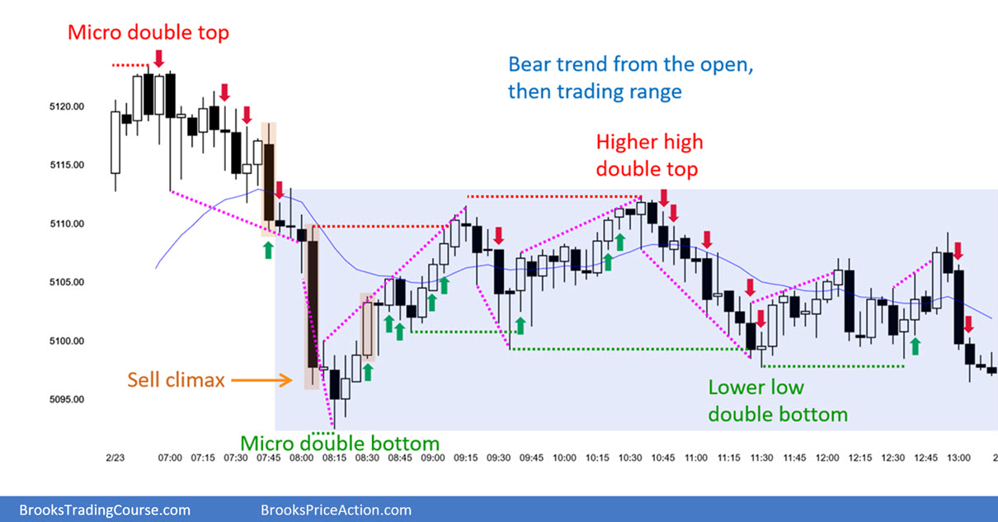
1: Why is this a sell point? There was a strong market uptrend . What was the Confirmation that this was not a consolidation vs a sell point? Was the goal only to test the first candle (Yellow star) ?
1
2
3
4
5
2: Why would these be a sell? This is following a 30 bar uptrend, hitting a previous support level that seems to have failed twice ( blue star) , and has rejected off a moving average. I would not classify “good follow through bars.” at this point. Additionally 10 bars and wedge pattern would there be an expectation for it to go up? I did get profitable on this push down but closed to early missing most of the surprise. But also lost money on the three doji and the hammer bars .
3: Why Sell? There are two pushes up however the second bear bar had a large wick that rejected off the resistance point of the previous two leg upswing?
4: Why buy here knowing there in not a 1:2 risk: reward and that ‘Most Breakouts fail? A buy at 5108, the minimum risk would be 5104 but as Mentioned in AL’s videos the more appropriate would be maybe 5101. Risk about 6 points: therefore price point would need to be 5120. At this point has a trading range been established? Same question with 5.

